Slide 1
Data@ANZ
selvakumar13599@gmail.com

Slide 2
Inference
The dataset from ANZ Bank which contained transactions of 100 customers was given and we were required to build a linear regression model.

Slide 3
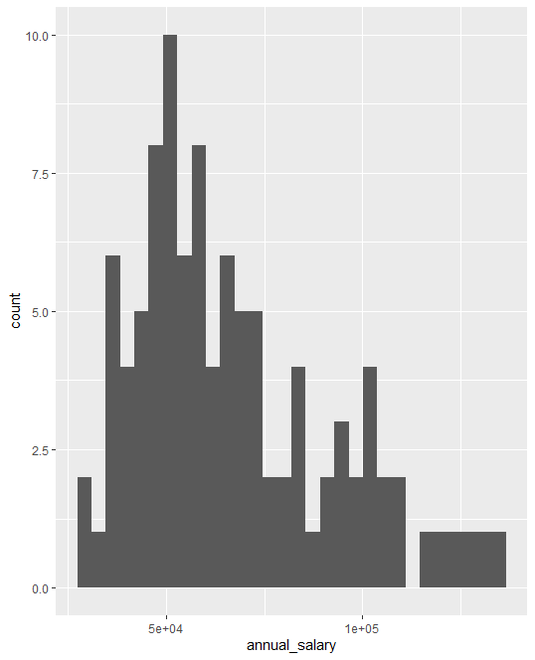
Annual salary histogram.

Slide 4
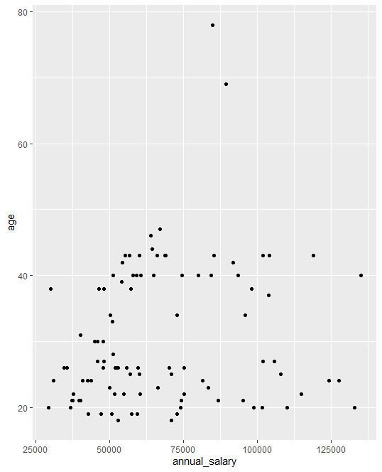
Annual salary vs age.

Slide 5
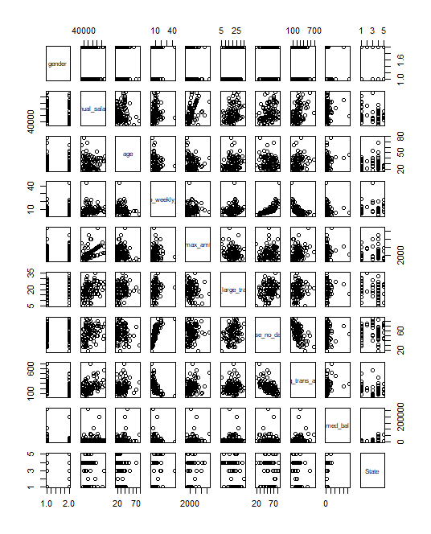
Correlation plot of customer attributes.

Slide 6
Inference from linear regression model.
The linear regression model achieved an R-squared value of 0.139. As the R-squared value is closer to 0, it indicates that the model explains very little of the variability of the annual salary.
The model also achieved a Root Mean Squared Error (RMSE) of 15578. It is the square root of the variance of the residuals. Residuals are a measure of how far from the regression line the data points are. In general, the lower the RMSE, the better the model is.
Hence, this Linear Regression model has performed very poorly in predicting the average salary of an ANZ customer.

Slide 7
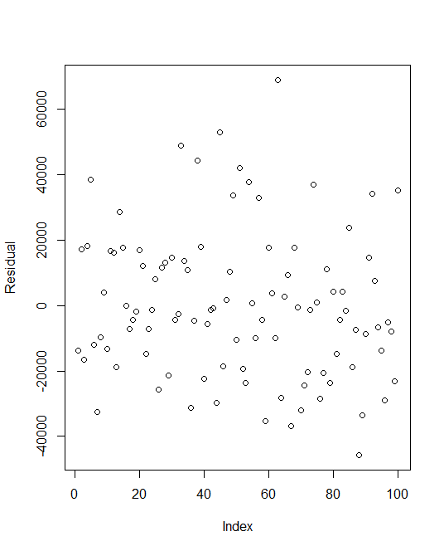
Residual plot of the LM.

